Slide 1

A Comparative Study of Cloud Hosting Platforms for Web and API Deployments

Slide 2
introduction
Good [morning/afternoon], everyone. My name is Ajinkya Wagh, and I am currently pursuing my Bachelor of Engineering in Computer Science and Engineering. As part of my internship project, I conducted a research-based analysis of modern cloud hosting platforms that are ideal for deploying various types of software projects.
The project, titled “A Comparative Study of Cloud Hosting Platforms for Web and API Deployments”, focuses on comparing six leading cloud platforms—Heroku, Render, Vercel, DigitalOcean App Platform, Google Cloud Platform, and AWS—based on their ability to host web applications, API-based projects, and static or dynamic websites.
I explored their service models, developer experience, scalability, and real-world suitability by actually deploying live web and API projects on selected platforms. This research aims to guide developers in choosing the right deployment solution based on their project needs and technical priorities.

Slide 3

The 2025 Cloud Hosting Landscape
An analysis of modern Platform as a Service (PaaS) and Serverless
Providers, guiding developers to the best deployment solutions for their
Web applications, APIs, and website

Slide 4
Market at a Glance
The developer-focused cloud market is dominated by platforms that simplify infrastructure management, allowing teams to focus solely on code. Our research analyzed leading platforms to understand their core offerings and market positioning. The landscape is primarily split between versatile Platform as a Service (PaaS) solutions and specialized Serverless environments.

Slide 5
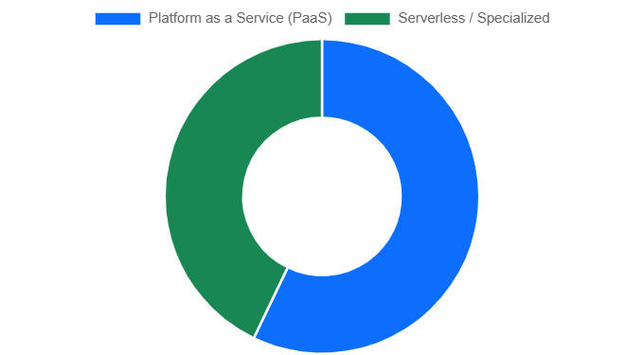
Platform Service Models
This chart illustrates the distribution of primary service models among the analyzed platforms. PaaS remains a dominant model, offering a balance of control and convenience, while specialized Serverless/hosting platforms are gaining significant traction for their efficiency and scalability.

Slide 6
6
Key Platforms Analyzed
100%
Git-Based Deployment
83%
Offer Free Tiers
5+
Languages Supported

Slide 7
The Contenders: A Closer Look
We analyzed six leading platforms, each offering a unique value proposition for developers. From industry veterans known for their simplicity to modern platforms built for scalability and specialized workloads, these are the top choices for deploying applications in 2025.

Slide 8
Heroku
A pioneer in the PaaS space, Heroku is celebrated for its developer-friendly workflow and seamless Git integration, making it a go-to for rapid deployment of web apps and APIs.
Render
A modern, unified cloud platform, Render simplifies deployment for a wide range of services, including static sites, web apps, and databases, with a generous free tier.
Vercel
Highly optimized for frontend frameworks and static sites, Vercel offers incredibly fast deployments and a powerful global CDN, with robust support for serverless backend functions.

Slide 9
DigitalOcean App Platform
Built on reliable infrastructure, this fully managed PaaS offering simplifies deployment from Git repositories, handling infrastructure, runtime, and dependencies automatically.
Google Cloud Platform
Offers highly scalable services like Cloud Run for containerized apps that scale to zero, and App Engine, providing immense power and a generous free tier for developers.
Amazon Web Services
The most comprehensive cloud provider. Elastic Beanstalk (PaaS) and Amplify (hosting) simplify deployment on its vast, scalable infrastructure, backed by a substantial free tier.

Slide 10
Platform Feature Comparison
To provide a clearer comparison, we rated each platform across five key developer-centric metrics. This visualization helps identify which platform aligns best with specific project priorities, whether it's ease of use for a new project or raw scalability for a high-traffic application.

Slide 11
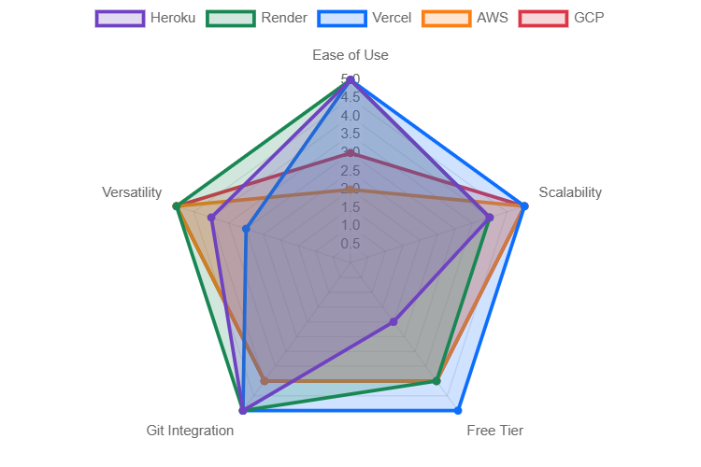
Developer Experience Metrics
This radar chart compares platforms on a 1-5 scale for Ease of Use, Scalability, Free Tier value, Git Integration quality, and overall Versatility. Vercel and Render score high on developer experience, while AWS and GCP lead in raw power and scalability.

Slide 12
Project Workload Suitability
Not all platforms are created equal for every task. We analyzed each platform's suitability for three common project types: dynamic web applications, backend APIs, and static websites. The results highlight the specialized strengths of each service.

Slide 13
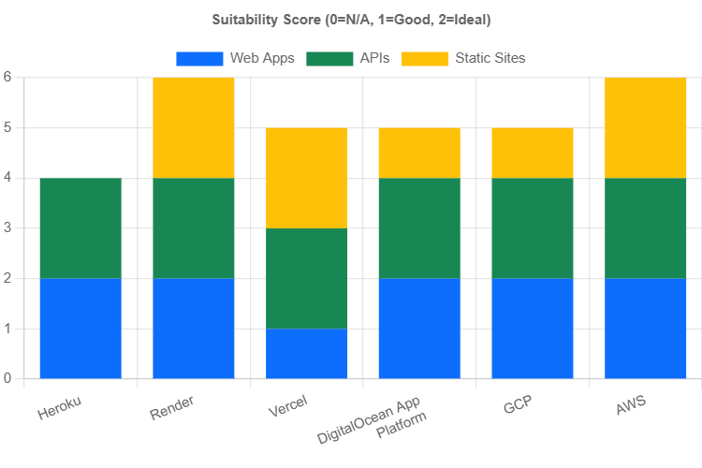
Best Platform by Project Type
This chart visualizes how well each platform supports different workloads. While most are versatile, platforms like Vercel show a clear specialization in static sites and APIs, whereas traditional PaaS offerings like Heroku and DigitalOcean provide strong, balanced support for web applications

Slide 14
The Modern Deployment Workflow
A key advantage of these platforms is the streamlined continuous deployment (CI/CD) pipeline they enable. The process is standardized across most providers, transforming code on a developer's machine into a live, public application with minimal friction.

Slide 15
💻 Code Locally
📂 Push to Git
Repo
🔗 Platform Connects
& Builds
🌍 Project is Live!
🚀 Deploy to Cloud
This HTML/CSS-based flowchart shows the simple, five-step process common to all analyzed platforms. By connecting a Git repository, developers automate the build and deploy stages, significantly accelerating development cycles

Slide 16
Key Takeaways for Developers
For Ease of Use & Rapid Prototyping: Heroku, Render, and Vercel offer the most intuitive developer experiences.
For Maximum Scalability & Power: AWS and Google Cloud Platform provide unmatched infrastructure and a vast ecosystem of services for large-scale applications.
For Balanced Performance & Simplicity: DigitalOcean App Platform and Render strike an excellent balance, making them great all-rounders.

